Slide 1



Noida Institute of Engineering and Technology, Greater Noida
RELATIONAL DATABASE THEORY AND CONCEPTS
Unit: 1
Advance database management system
Shruti Dadhich
AIML dept
B Tech 6th Sem

Slide 2
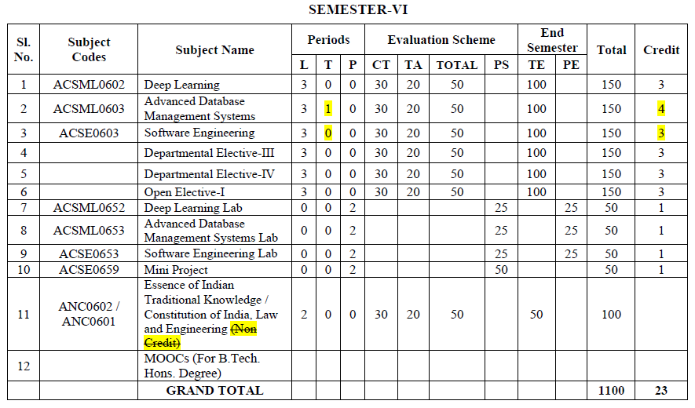
Evaluation Scheme

Slide 3
Syllabus
Introduction to relational database: Describe the relational model: Conformity and integrity, Use of constraints, Mapping design approaches to relational systems, Processing database data: Describe advanced SQL programming,
Query optimization: Query transformations, Optimization approaches, Use of constraints, Creation and use of a variety of index types.
Concurrency control and transaction management: The ACID principle, Two-phase locking and Deadlocks, Recovery and transaction design.

Slide 4
Branch wise Application
There are various application of Advance DBMS in different fields like:
Railway Reservation System,
Library Management System,
Banking,
Universities and colleges,
Credit card transactions etc.

Slide 5
Course Objective
This course provides an introduction to the advanced database management system.
The course introduces both theoretical (knowledge-based) and practical approaches, illustrate the use of advanced database and tools in a variety of application areas, as well as provide insight into many open research problems.

Slide 6
Content
Introduction to relational database
Describe the relational model Conformity and integrity
Use of constraints
Mapping design approaches to relational systems
Processing database data
Describe advanced SQL programming
Query optimization
Query transformations
Optimization approaches
Use of constraints
Creation and use of a variety of index types
Concurrency control and transaction management
The ACID principle
Two-phase locking and Deadlocks
Recovery and transaction design

Slide 7
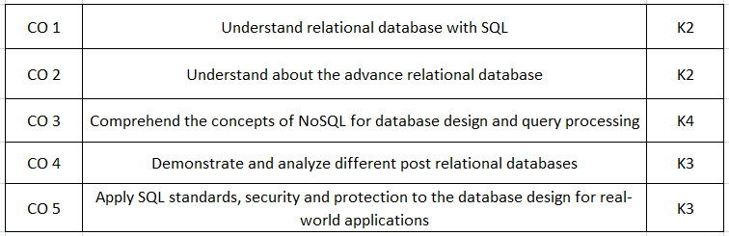
Course Outcomes(COs)

Slide 8
Program Outcomes (POs)
Engineering Graduates will be able to:
1. Engineering knowledge: Apply the knowledge of mathematics, science, engineering fundamentals, and an engineering specialization to the solution of complex engineering problems.
2. Problem analysis: Identify, formulate, review research literature, and analyze complex engineering problems reaching substantiated conclusions using first principles of mathematics, natural sciences, and engineering sciences.
3. Design/development of solutions: Design solutions for complex engineering problems and design system components or processes that meet the specified needs with appropriate consideration for the public health and safety, and the cultural, societal, and environmental considerations.
4. Conduct investigations of complex problems: Use research-based knowledge and research methods including design of experiments, analysis and interpretation of data, and synthesis of the information to provide valid conclusions.

Slide 9
Program Outcomes (POs)
5. Modern tool usage: Create, select, and apply appropriate techniques, resources, and modern engineering and IT tools including prediction and modeling to complex engineering activities with an understanding of the limitations.
6. The engineer and society: Apply reasoning informed by the contextual knowledge to assess societal, health, safety, legal and cultural issues and the consequent responsibilities relevant to the professional engineering practice.
7. Environment and sustainability: Understand the impact of the professional engineering solutions in societal and environmental contexts, and demonstrate the knowledge of, and need for sustainable development.
8. Ethics: Apply ethical principles and commit to professional ethics and responsibilities and norms of the engineering practice.

Slide 10
Program Outcomes (POs)
9. Individual and team work: Function effectively as an individual, and as a member or leader in diverse teams, and in multidisciplinary settings.
10. Communication: Communicate effectively on complex engineering activities with the engineering community and with society at large, such as, being able to comprehend and write effective reports and design documentation, make effective presentations, and give and receive clear instructions.
11. Project management and finance: Demonstrate knowledge and understanding of the engineering and management principles and apply these to one’s own work, as a member and leader in a team, to manage projects and in multidisciplinary environments.
12. Life-long learning: Recognize the need for, and have the preparation and ability to engage in independent and life-long learning in the broadest context of technological change.

Slide 11
Program Educational Objectives (PEOs)
PEO1:
Able to apply sound knowledge in the field of information technology to fulfill the needs of IT industry.
PEO2:
Able to design innovative and interdisciplinary systems through latest digital technologies.
PEO3:
Able to inculcate professional ethics, team work and leadership for serving the society.
PEO4:
Able to inculcate lifelong learning in the field of computing for successful career in organizations and R&D sectors.

Slide 12
COs and POs Mapping
 | PO1 | PO2 | PO3 | PO4 | PO5 | PO6 | PO7 | PO8 | PO9 | PO10 | PO11 | PO12
 | 2 | 2 | 3 | 3 | 3 | 2 | 3 | 2 | 2 | 2 | 2 | 3
KCS501.2 | 3 | 3 | 3 | 2 | 2 | 2 | 2 | 2 | 2 | 2 | 2 | 3
KCS501.3 | 2 | 3 | 3 | 3 | 3 | 2 | 2 | 2 | 2 | 2 | 2 | 2
KCS501.4 | 2 | 3 | 2 | 2 | 2 | 2 | 2 | 2 | 2 | 3 | 2 | 2
KCS501.5 | 2 | 3 | 2 | 2 | 2 | 3 | 2 | 2 | 3 | 2 | 2 | 2
AVG | 2.20 | 2.80 | 2.60 | 2.40 | 2.40 | 2.20 | 2.20 | 2.00 | 2.20 | 2.20 | 2.00 | 2.40

Slide 13
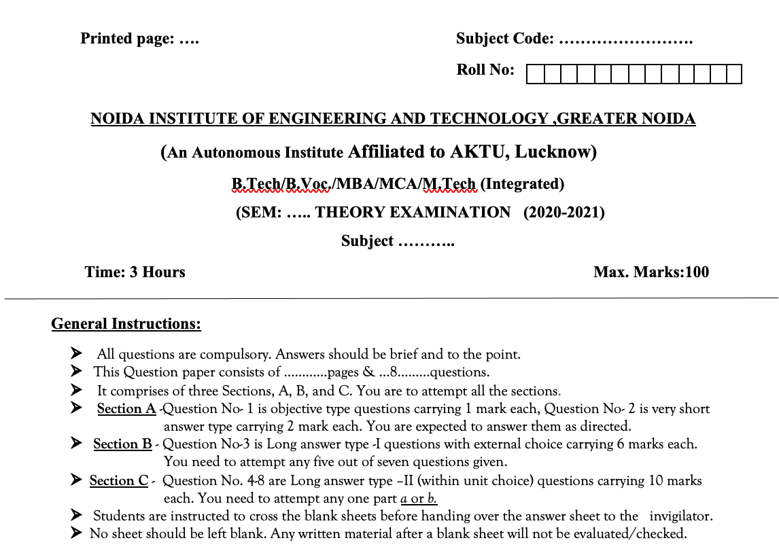
Question Paper Template

Slide 14
Question Paper Template
 |  | SECTION – A |  | CO
 | Attempt all parts- |  | [10×1=10]
 | 1-a. | Question- | (1)
 | 1-b. | Question- | (1)
 | 1-c. | Question- | (1)
 | 1-d. | Question- | (1)
 | 1-e. | Question- | (1)
 | 1-f. | Question- | (1)
 | 1-g. | Question- | (1)
 | 1-h. | Question- | (1)
 | 1-i. | Question- | (1)
 | 1-j. | Question- | (1)
2. | Attempt all parts- |  | [5×2=10] | CO
 | 2-a. | Question- | (2)
 | 2-b. | Question- | (2)
 | 2-c. | Question- | (2)
 | 2-d. | Question- | (2)
 | 2-e. | Question- | (2)
SECTION – B |  |  |  | CO
3. | Answer any five of the following- |  | [5×6=30]
 | 3-a. | Question- | (6)
 | 3-b. | Question- | (6)
 | 3-c. | Question- | (6)
 | 3-d. | Question- | (6)
 | 3-e. | Question- | (6)
 | 3-f. | Question- | (6)
 | 3-g. | Question- | (6)
SECTION – C |  |  |  | CO
4 | Answer any one of the following- |  | [5×10=50]
 | 4-a. | Question- | (10)
 | 4-b. | Question- | (10)
5. | Answer any one of the following-
 | 5-a. | Question- | (10)
 | 5-b. | Question- | (10)
6. | Answer any one of the following-
 | 6-a. | Question- | (10)
 | 6-b. | Question- | (10)
7. | Answer any one of the following-
 | 7-a. | Question- | (10)
 | 7-b. | Question- | (10)
8. | Answer any one of the following-
 | 8-a. | Question- | (10)
 | 8-b. | Question- | (10)

Slide 15
Prerequisite and Recap
The student should have knowledge of relational database management system (RDBMS) and SQL.
Having knowledge of basic mathematics like - SUM, DIFFERENCE, AVERAGE, MEAN, MEDIAN, MODE, etc will definitely be a plus point.
Having knowledge on Set Theory will help.
The proper understanding of data structures (B and B+ trees) will help you to understand the DBMS quickly.

Slide 16
Unit Objective
Students will be able to learn various Relational Data Model Concepts, constraints, Relational Algebra and Relational Calculus
Introduction on SQL and Various queries and operations in SQL which helps to communicate with the database. Along with cursors, Triggers and Procedures in SQL/PL SQL.

Slide 17
RDBMS: Introduction
All modern database management systems like SQL, MS SQL Server, IBM DB2, ORACLE, My-SQL, and Microsoft Access are based on RDBMS. It is called Relational Database Management System (RDBMS) because it is based on the relational model introduced by E.F. Codd.
How it works: Data is represented in terms of tuples (rows) in RDBMS.
A relational database is the most commonly used database. It contains several tables, and each table has its primary key.
Brief History of RDBMS:
From 1970 to 1972, E.F. Codd published a paper to propose using a relational database model.
RDBMS is originally based on E.F. Codd's relational model invention.

Slide 18

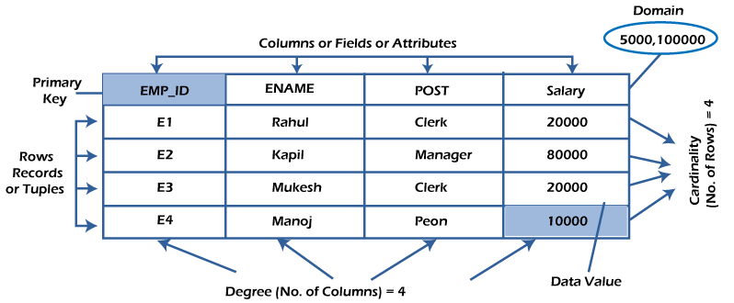
Conti..
Following are the various terminologies of RDBMS:

Slide 19
Conti..
Relation:
Everything in a relational database is stored in the form of relations. The RDBMS database uses tables to store data. A table is a collection of related data entries and contains rows and columns to store data.
Properties of a Relation:
Each relation has a unique name by which it is identified in the database.
Relation does not contain duplicate tuples.
The tuples of a relation have no specific order.
All attributes in a relation are atomic, i.e., each cell of a relation contains exactly one value.

Slide 20
Conti..
Row or Record: A row of a table is also called a record or tuple. It contains the specific information of each entry in the table. It is a horizontal entity in the table.
Properties of a row:
No two tuples are identical to each other in all their entries.
All tuples of the relation have the same format and the same number of entries.
The order of the tuple is irrelevant. They are identified by their content, not by their position.
Column/Attribute:
A column is a vertical entity in the table which contains all information associated with a specific field in a table. For example, "name" is a column in the above table which contains all information about a student's name.

Slide 21
Conti..
Properties of an Attribute:
Every attribute of a relation must have a name.
Null values are permitted for the attributes.
Default values can be specified for an attribute automatically inserted if no other value is specified for an attribute.
Attributes that uniquely identify each tuple of a relation are the primary key.
Data item/Cells:
The smallest unit of data in the table is the individual data item. It is stored at the intersection of tuples and attributes.
Properties of data items:
Data items are atomic.
The data items for an attribute should be drawn from the same domain.

Slide 22
Conti..
Degree:
The total number of attributes that comprise a relation is known as the degree of the table.
Cardinality:
The total number of tuples at any one time in a relation is known as the table's cardinality. The relation whose cardinality is 0 is called an empty table.
Domain:
The domain refers to the possible values each attribute can contain. It can be specified using standard data types such as integers, floating numbers, etc. For example, An attribute entitled Marital_Status may be limited to married or unmarried values.
NULL Values:
The NULL value of the table specifies that the field has been left blank during record creation. It is different from the value filled with zero or a field that contains space.

Slide 23
Relational Database
Relational Model
Relational Model was proposed by E.F. Codd to model data in the form of relations or tables. After designing the conceptual model of Database using ER diagram, we need to convert the conceptual model in the relational model which can be implemented using any RDBMS languages like Oracle SQL, MySQL etc.
Relational Model represents how data is stored in Relational Databases. A relational database stores data in the form of relations (tables). Consider a relation STUDENT with attributes ROLL_NO, NAME, ADDRESS, PHONE and AGE.

Slide 24
Conti…
Domain: It contains a set of atomic values that an attribute can take.
Attribute: It contains the name of a column in a particular table. Each attribute Ai must have a domain, dom(Ai)
Relational instance: In the relational database system, the relational instance is represented by a finite set of tuples. Relation instances do not have duplicate tuples.
Relational schema: A relational schema contains the name of the relation and name of all columns or attributes.
Relational key: In the relational key, each row has one or more attributes. It can identify the row in the relation uniquely.

Slide 25
Conti…
Relational Integrity Constraints:
Relational Integrity constraints in DBMS are referred to conditions which must be present for a valid relation. These Relational constraints in DBMS are derived from the rules in the mini-world that the database represents.
There are many types of Integrity Constraints in DBMS. Constraints on the Relational database management system is mostly divided into three main categories are:
Domain Constraints
Key Constraints
Referential Integrity Constraints

Slide 26
Conti..
Domain Constraints
Domain constraints specify that within each tuple, and the value of each attribute must be unique. This is specified as data types which include standard data types integers, real numbers, characters, Booleans, variable length strings, etc.
Key Constraints
An attribute that can uniquely identify a tuple in a relation is called the key of the table. The value of the attribute for different tuples in the relation has to be unique.

Slide 27
Constraints on Relational database model
On modeling the design of the relational database we can put some restrictions like what values are allowed to be inserted in the relation, what kind of modifications and deletions are allowed in the relation.
Constraints in the databases can be categorized into 3 main categories:
Constraints that are applied in the data model is called Implicit constraints.
Constraints that are directly applied in the schemas of the data model, by specifying them in the DDL. These are called as schema-based constraints or Explicit constraints.
Constraints that cannot be directly applied in the schemas of the data model. We call these Application based or semantic constraints.

Slide 28
Conti…
Mainly Constraints on the relational database are of 4 types:
Domain constraints
Key constraints
Entity Integrity constraints
Referential integrity constraints
1. Domain constraints :
Every domain must contain atomic values(smallest indivisible units) it means composite and multi-valued attributes are not allowed.
We perform datatype check here, which means when we assign a data type to a column we limit the values that it can contain. Eg. If we assign the data type of attribute age as int, we can’t give it values other then int data type.

Slide 29
Conti…
2. Key Constraints or Uniqueness Constraints :
These are called uniqueness constraints since it ensures that every tuple in the relation should be unique.
A relation can have multiple keys or candidate keys(minimal superkey), out of which we choose one of the keys as primary key, we don’t have any restriction on choosing the primary key out of candidate keys, but it is suggested to go with the candidate key with less number of attributes.
Null values are not allowed in the primary key, hence Not Null constraint is also a part of key constraint.
3. Entity Integrity Constraints :
Entity Integrity constraints says that no primary key can take NULL value, since using primary key we identify each tuple uniquely in a relation.

Slide 30
Conti…
4. Referential Integrity Constraints :
The Referential integrity constraints is specified between two relations or tables and used to maintain the consistency among the tuples in two relations.
This constraint is enforced through foreign key, when an attribute in the foreign key of relation R1 have the same domain(s) as the primary key of relation R2, then the foreign key of R1 is said to reference or refer to the primary key of relation R2.
The values of the foreign key in a tuple of relation R1 can either take the values of the primary key for some tuple in relation R2, or can take NULL values, but can’t be empty.

Slide 31
Processing database data: Describe advanced SQL programming
Query Processing is the activity performed in extracting data from the database. In query processing, it takes various steps for fetching the data from the database. The steps involved are:
Parsing and translation
Optimization
Evaluation
The query processing works in the following way:
Parsing and Translation:
As query processing includes certain activities for data retrieval. Initially, the given user queries get translated in high-level database languages such as SQL. It gets translated into expressions that can be further used at the physical level of the file system. After this, the actual evaluation of the queries and a variety of query -optimizing transformations and takes place.

Slide 32
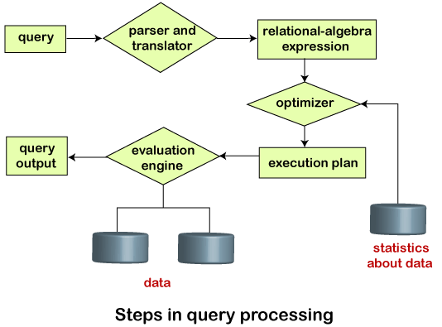
Conti…

Slide 33
Conti…
Evaluation:
For this, with addition to the relational algebra translation, it is required to annotate the translated relational algebra expression with the instructions used for specifying and evaluating each operation. Thus, after translating the user query, the system executes a query evaluation plan.
Query Evaluation Plan:
The annotations in the evaluation plan may refer to the algorithms to be used for the particular index or the specific operations.
Such relational algebra with annotations is referred to as Evaluation Primitives. The evaluation primitives carry the instructions needed for the evaluation of the operation.

Slide 34
Conti…
Thus, a query evaluation plan defines a sequence of primitive operations used for evaluating a query. The query evaluation plan is also referred to as the query execution plan.
A query execution engine is responsible for generating the output of the given query. It takes the query execution plan, executes it, and finally makes the output for the user query.

Slide 35
Conti…
Optimization:
The cost of the query evaluation can vary for different types of queries. Although the system is responsible for constructing the evaluation plan, the user does need not to write their query efficiently.
Usually, a database system generates an efficient query evaluation plan, which minimizes its cost. This type of task performed by the database system and is known as Query Optimization.
For optimizing a query, the query optimizer should have an estimated cost analysis of each operation. It is because the overall operation cost depends on the memory allocations to several operations, execution costs, and so on.
Finally, after selecting an evaluation plan, the system evaluates the query and produces the output of the query.

Slide 36
Query Transformation
Query transformation is a set of techniques used by the optimizer to rewrite a query and optimizer it better.
SQL Transformation is a connected transformation used to process SQL queries in the midstream of a pipeline. We can insert, update, delete and retrieve rows from the database at run time using the SQL transformation. The SQL transformation processes external SQL scripts or SQL queries created in the SQL editor. You can also pass the database connection information to the SQL transformation as an input data at run time.

Slide 37
Conti…
The following SQL statements can be used in the SQL transformation.
Data Definition Statements (CREATE, ALTER, DROP, TRUNCATE, RENAME)
DATA MANIPULATION statements (INSERT, UPDATE, DELETE, MERGE)
DATA Retrieval Statement (SELECT)
DATA Control Language Statements (GRANT, REVOKE)
Transaction Control Statements (COMMIT, ROLLBACK)
Configuring SQL Transformation:
The following options can be used to configure an SQL transformation:
Mode: SQL transformation runs either in script mode or query mode.
Active/Passive: By default, SQL transformation is an active transformation. You can configure it as passive transformation.

Slide 38
Conti…
Database Type: The type of database that the SQL transformation connects to.
Connection type: You can pass database connection information or you can use a connection object.
Creating SQL Transformation in Query Mode:
Query Mode: The SQL transformation executes a query that defined in the query editor. You can pass parameters to the query to define dynamic queries. The SQL transformation can output multiple rows when the query has a select statement. In query mode, the SQL transformation acts as an active transformation.

Slide 39
Query Optimization
The query optimizer (called simply the optimizer) is built-in database software that determines the most efficient method for a SQL statement to access requested data.
This section contains the following topics:
Purpose of a query optimizer
Cost based optimizer
Executive plan
Purpose of the Query Optimizer:
The optimizer attempts to generate the most optimal execution plan for a SQL statement.

Slide 40
Conti…
The optimizer choose the plan with the lowest cost among all considered candidate plans. The optimizer uses available statistics to calculate cost. For a specific query in a given environment, the cost computation accounts for factors of query execution such as I/O, CPU, and communication.
For example, a query might request information about employees who are managers. If the optimizer statistics indicate that 80% of employees are managers, then the optimizer may decide that a full table scan is most efficient. However, if statistics indicate that very few employees are managers, then reading an index followed by a table access by rowid may be more efficient than a full table scan.

Slide 41
Conti…
Because the database has many internal statistics and tools at its disposal, the optimizer is usually in a better position than the user to determine the optimal method of statement execution. For this reason, all SQL statements use the optimizer.
Cost-Based Optimization:
Query optimization is the overall process of choosing the most efficient means of executing a SQL statement. SQL is a nonprocedural language, so the optimizer is free to merge, reorganize, and process in any order.
The database optimizes each SQL statement based on statistics collected about the accessed data. The optimizer determines the optimal plan for a SQL statement by examining multiple access methods, such as full table scan or index scans, different join methods such as nested loops and hash joins, different join orders, and possible transformations.

Slide 42
Conti…
For a given query and environment, the optimizer assigns a relative numerical cost to each step of a possible plan, and then factors these values together to generate an overall cost estimate for the plan. After calculating the costs of alternative plans, the optimizer chooses the plan with the lowest cost estimate. For this reason, the optimizer is sometimes called the cost-based optimizer (CBO) to contrast it with the legacy rule-based optimizer (RBO).

Slide 43
Conti…
Execution Plans:
An execution plan describes a recommended method of execution for a SQL statement.
The plan shows the combination of the steps Oracle Database uses to execute a SQL statement. Each step either retrieves rows of data physically from the database or prepares them for the user issuing the statement.
An execution plan displays the cost of the entire plan, indicated on line 0, and each separate operation. The cost is an internal unit that the execution plan only displays to allow for plan comparisons. Thus, you cannot tune or change the cost value.
In the following graphic, the optimizer generates two possible execution plans for an input SQL statement, uses statistics to estimate their costs, compares their costs, and then chooses the plan with the lowest cost.

Slide 44
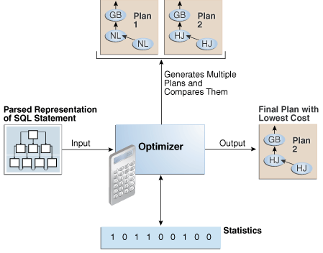
Conti…

Slide 45
Indexes and Constraints
Indexes and constraints are used to reinforce data integrity and increase database performance. Using indexes and constraints, you can access information from the database quicker and guarantee the referential integrity of information. The following sections describe indexes, keys, and constraints.
Indexes:
An index is a set of ordered references to rows of a table. It can contain data from one or more columns of a table. An index improves the performance of data retrieval by reducing the number of physical pages that the database must access in order to read a row in the database. Because indexes store data in order, they also eliminate the need to create temporary storage for the ORDER BY clause if the relevant column is included in an index. Every index has a header.

Slide 46
Conti…
which contains the following information:
The depth of the index
Number of leaf pages
The selectivity factor
The Point Base RDBMS builds and maintains indexes without user intervention and provides current information to the query optimizer.
Keys:
In a database, a key consists of one or more columns of a table that have been granted specific properties. When defining a table or index, you specify the key (primary or foreign).

Slide 47
Conti..
Supports the following types of keys:
Primary Key
The primary key is used as a master reference for columns defined as foreign keys in other tables. Foreign keys can only contain values defined in the Primary key to which they refer. A table can only have one primary key, and the key must contain only unique values without any NULL values. The table containing the primary key is referred to as the parent table.

Slide 48
Conti..
Foreign Key
A foreign key associates values contained in one or more columns of a table to primary keys of other tables. The table containing the foreign key is referred to as the child table.
The child table references a parent table, which must contain a primary key. A column defined as a foreign key cannot contain NULL values. The values in a foreign key column must match either all the values, or a subset of the values in the referenced Primary Key. A foreign key cannot contain values that are not in the primary key to which it refers.

Slide 49
Conti..
Constraints:
Constraints are rules that the database enforces to improve data integrity. You can specify all of the following constraints at either the column level or at the table level in the Point Base RDBMS
Unique Constraint
A unique constraint forces a column to contain only unique values. Point Base allows NULL values in unique columns, unless you specify NOT NULL when creating or altering a table. When creating or altering a table, you must define unique constraints. However, you can also create a unique constraint automatically when you create a primary key. Although a table can contain any number of unique columns, only one can be the primary key.
NOTE: Whenever you specify a unique constraint, Point Base creates a unique index automatically.

Slide 50
Conti..
Referential Constraint
You can use a referential constraint to link foreign key columns with primary key columns. You can define referential constraints as you create or alter a table.
Check Constraint
The body of a check constraint is a search condition. You can use a check constraint to make sure that a value going into a column meets the criteria of the search condition. Similar to the other constraints, you can define a check constraint when creating or altering a table. However, you can also use this constraint when updating a column(s) of a table. The value being inserted or modified (through an UPDATE) must cause the search condition to evaluate to TRUE, in order for the data to be inserted or updated.

Slide 51
Transaction and Concurrency Control
you have learned about the functions that the DBMS should have. Among these, some closely related functions are proposed to make sure that any database should be reliable and remain in a steady state.
The names of the functions are:
Transaction support.
Concurrency Control.
Although each function can be discussed discretely, they are mutually dependent. Many DBMSs allow users to carry out simultaneous operations on the database.
If these operations are not restricted, the accesses may get in the way with one another, and the database can become incompatible. For defeating this problem, the DBMS implements a concurrency control technique using a protocol that prevents database accesses from prying with one another.

Slide 52
What is Transaction?
A set of logically related operations is known as a transaction. The main operations of a transaction are:
Read (A): Read operations Read(A) or R(A) reads the value of A from the database and stores it in a buffer in the main memory.
Write (A): Write operation Write(A) or W(A) writes the value back to the database from the buffer.
Commit: After all instructions of a transaction are successfully executed, the changes made by a transaction are made permanent in the database.
Rollback: If a transaction is not able to execute all operations successfully, all the changes made by a transaction are undone.

Slide 53
Conti…
Let us take a debit transaction from an account that consists of the following operations:
R(A);
A=A-1000;
W(A);
Assume A’s value before starting the transaction is 5000.
The first operation reads the value of A from the database and stores it in a buffer.
the Second operation will decrease its value by 1000. So buffer will contain 4000.
the Third operation will write the value from the buffer to the database. So A’s final value will be 4000.

Slide 54
Conti..
For Example, with T1 (debit of Rs. 1000 from A) and T2 (credit of 500 to A) executing concurrently, the database reaches an inconsistent state.
Let us assume the Account balance of A is Rs. 5000. T1 reads A(5000) and stores the value in its local buffer space. Then T2 reads A(5000) and also stores the value in its local buffer space.
T1 performs A=A-1000 (5000-1000=4000) and 4000 is stored in T1 buffer space. Then T2 performs A=A+500 (5000+500=5500) and 5500 is stored in the T2 buffer space. T1 writes the value from its buffer back to the database.
A’s value is updated to 4000 in the database and then T2 writes the value from its buffer back to the database. A’s value is updated to 5500 which shows that the effect of the debit transaction is lost and the database has become inconsistent.
To maintain consistency of the database, we need concurrency control protocols.

Slide 55
What is Concurrency control?
It is the method of managing concurrent operations on the database without getting any obstruction with one another.
Concurrency control technique implements some protocols which can be broadly classified into two categories. These are:
Lock-based protocol:
Those database systems that are prepared with the concept of lock-based protocols employ a mechanism where any transaction cannot read or write data until it gains a suitable lock on it.

Slide 56
Conti…
Timestamp-based Protocol: It is the most frequently used concurrency protocol is the timestamp-based protocol. This protocol uses either system time or logical counter as a timestamp.
Advantages of Concurrency:
In general, concurrency means, that more than one transaction can work on a system.
The advantages of a concurrent system are:
Waiting Time: It means if a process is in a ready state but still the process does not get the system to get execute is called waiting time. So, concurrency leads to less waiting time.

Slide 57
Conti…
Response Time: The time wasted in getting the response from the cpu for the first time, is called response time. So, concurrency leads to less Response Time.
Resource Utilization: The amount of Resource utilization in a particular system is called Resource Utilization. Multiple transactions can run parallel in a system. So, concurrency leads to more Resource Utilization.
Efficiency: The amount of output produced in comparison to given input is called efficiency. So, Concurrency leads to more Efficiency.

Slide 58
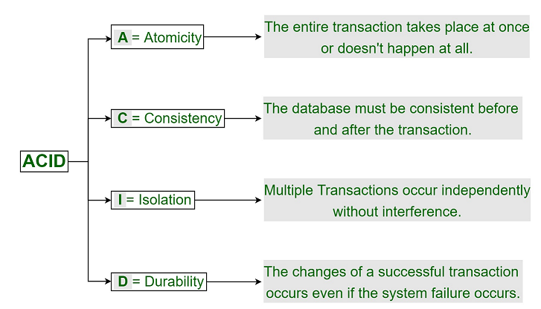
The principle of ACID Property
In order to maintain consistency in a database, before and after the transaction, certain properties are followed. These are called ACID properties.
ACID properties:

Slide 59
Conti…
Atomicity:
By this, we mean that either the entire transaction takes place at once or doesn’t happen at all. There is no midway i.e. transactions do not occur partially. Each transaction is considered as one unit and either runs to completion or is not executed at all. It involves the following two operations. —Abort: If a transaction aborts, changes made to the database are not visible. —Commit: If a transaction commits, changes made are visible. Atomicity is also known as the ‘All or nothing rule’.
Consider the following transaction T consisting of T1 and T2: Transfer of 100 from account X to account Y.

Slide 60
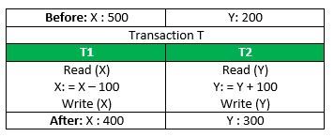
Conti…

Slide 61
Conti…
If the transaction fails after completion of T1 but before completion of T2.( say, after write(X) but before write(Y)), then the amount has been deducted from X but not added to Y. This results in an inconsistent database state. Therefore, the transaction must be executed in its entirety in order to ensure the correctness of the database state.
Consistency:
This means that integrity constraints must be maintained so that the database is consistent before and after the transaction. It refers to the correctness of a database. Referring to the example above, the total amount before and after the transaction must be maintained. Total before T occurs = 500 + 200 = 700. Total after T occurs = 400 + 300 = 700.
Therefore, the database is consistent. Inconsistency occurs in case T1 completes but T2 fails. As a result, T is incomplete.

Slide 62
Conti…
Isolation:
This property ensures that multiple transactions can occur concurrently without leading to the inconsistency of the database state. Transactions occur independently without interference. Changes occurring in a particular transaction will not be visible to any other transaction until that particular change in that transaction is written to memory or has been committed. This property ensures that the execution of transactions concurrently will result in a state that is equivalent to a state achieved these were executed serially in
some order.

Slide 63
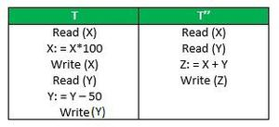
Conti…

Slide 64
Conti…
Let X= 500, Y = 500. Consider two transactions T and T”.
Suppose T has been executed till Read (Y) and then T’’ starts. As a result, interleaving of operations takes place due to which T’’ reads the correct value of X but the incorrect value of Y and sum computed by T”: (X+Y = 50, 000+500=50, 500) is thus not consistent with the sum at end of the transaction: T: (X+Y = 50, 000 + 450 = 50, 450).
This results in database inconsistency, due to a loss of 50 units. Hence, transactions must take place in isolation and changes should be visible only after they have been made to the main memory.

Slide 65
Two-Phase locking and Deadlock
Every transaction will lock and unlock the data item in two different phases.
Growing Phase − All the locks are issued in this phase. No locks are released, after all changes to data-items are committed and then the second phase (shrinking phase) starts.
Shrinking phase − No locks are issued in this phase, all the changes to data-items are noted (stored) and then locks are released.

Slide 66
Conti…
Durability:
This property ensures that once the transaction has completed execution, the updates and modifications to the database are stored in and written to disk and they persist even if a system failure occurs. These updates now become permanent and are stored in non-volatile memory. The effects of the transaction, thus, are never lost.

Slide 67
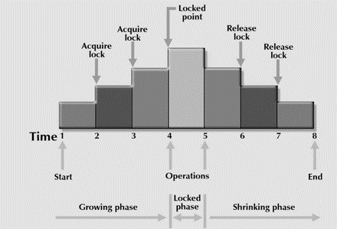
Conti…
The 2PL locking protocol is represented diagrammatically as follows −

Slide 68
Conti…
In the growing phase transaction reaches a point where all the locks it may need has been acquired. This point is called LOCK POINT.
After the lock point has been reached, the transaction enters a shrinking phase.
Types:
Two phase locking is of two types −
Strict two phase locking protocol:
A transaction can release a shared lock after the lock point, but it cannot release any exclusive lock until the transaction commits. This protocol creates a cascade less schedule.

Slide 69
Conti…
Cascading schedule: In this schedule one transaction is dependent on another transaction. So if one has to rollback then the other has to rollback.
Rigorous two phase locking protocol:
A transaction cannot release any lock either shared or exclusive until it commits.
The 2PL protocol guarantees serializability , but cannot guarantee that deadlock will not happen.

Slide 70
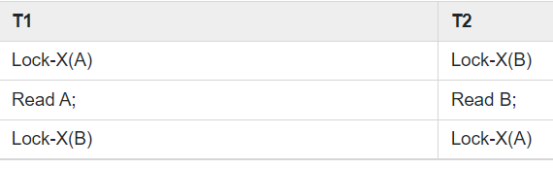
Conti…
Example
Let T1 and T2 are two transactions.
T1=A+B and T2=B+A
Here,
Lock-X(B) : Cannot execute Lock-X(B) since B is locked by T2.
Lock-X(A) : Cannot execute Lock-X(A) since A is locked by T1.
In the above situation T1 waits for B and T2 waits for A. The waiting time never ends. Both the transaction cannot proceed further at least any one releases the lock voluntarily. This situation is called deadlock.

Slide 71
Conti…
The wait for graph is as follows −
Wait for graph: It is used in the deadlock detection method, creating a node for each transaction, creating an edge Ti to Tj, if Ti is waiting to lock an item locked by Tj. A cycle in WFG indicates a deadlock has occurred. WFG is created at regular intervals.
Deadlock in 2-PL – Consider this simple example, it will be easy to understand. Say we have two transactions T₁ and T₂.

Slide 72
Conti…
Schedule: Lock-X₁(A) Lock-X₂(B) Lock-X₁(B) Lock-X₂(A)Drawing the precedence graph, you may detect the loop. So Deadlock is also possible in 2-PL.
Two-phase locking may also limit the amount of concurrency that occurs in a schedule because a Transaction may not be able to release an item after it has used it. This may be because of the protocols and other restrictions we may put on the schedule to ensure serializability, deadlock freedom, and other factors. This is the price we have to pay to ensure serializability and other factors, hence it can be considered as a bargain between concurrency and maintaining the ACID properties.

Slide 73
Recovery and Transaction Design
Recovery techniques are heavily dependent upon the existence of a special file known as a system log. It contains information about the start and end of each transaction and any updates which occur during the transaction. The log keeps track of all transaction operations that affect the values of database items. This information is needed to recover from transaction failure.
The log is kept on disk start_transaction(T): This log entry records that transaction T starts the execution.
Read_item(T, X): This log entry records that transaction T reads the value of database item X.
Write_item(T, X, old_value, new_value): This log entry records that transaction T changes the value of the database item X from old_value to new_value. The old value is sometimes known as a before an image of X, and the new value is known as an afterimage of X.

Slide 74
Two Phase locking and Deadlocks
Commit(T): This log entry records that transaction T has completed all accesses to the database successfully and its effect can be committed (recorded permanently) to the database.
Abort(T): This records that transaction T has been aborted.
Checkpoint: Checkpoint is a mechanism where all the previous logs are removed from the system and stored permanently in a storage disk. Checkpoint declares a point before which the DBMS was in a consistent state, and all the transactions were committed.

Slide 75

Previous year question paper

Slide 76
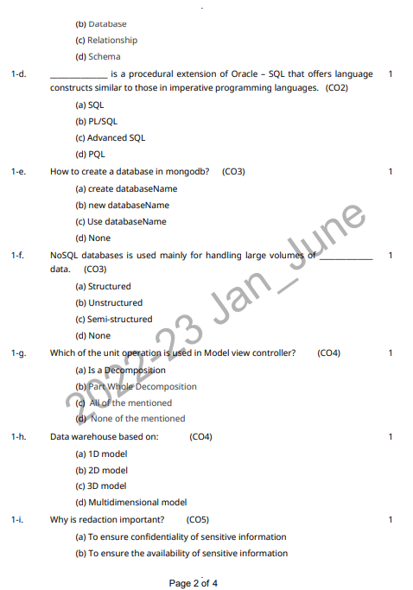
Previous year question paper

Slide 77

Previous year question paper

Slide 78

Previous year question paper

Slide 79
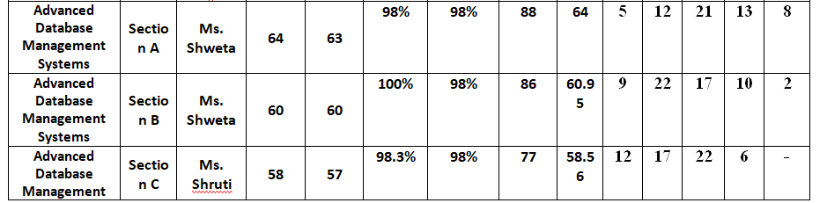
Result Analysis

Slide 80
MCQ
1. Which of the following is the full form of RDBMS?
a) Relational Data Management System
b) Relational Database Management System
c) Relative Database Management System
d) Regional Data Management System
2. What is an RDBMS?
a) Database that stores data elements that are not linked
b) Database that accesses data elements that are not linked
c) Database that stores and allows access to data elements that are linked
d) None of the mentioned
3. Does RDBMS have ACID properties?
a) Follows ACID properties
b) Doesn’t follow ACID properties
c) Depends on the data stored in the database
d) Can’t say
4. What is a relation in RDBMS?
a) Key
b) Table
c) Row
d) Data Types
5. Which of the following systems use RDMS?
a) Oracle
b) Microsoft SQLServer
c) IBM
d) All of the mentioned

Slide 81
Topic Links
https://www.geeksforgeeks.org/relational-model-in-dbms/ /
https://www.geeksforgeeks.org/sql-query-processing/
https://www.geeksforgeeks.org/best-practices-for-sql-query-optimizations/
https://www.geeksforgeeks.org/concurrency-control-in-dbms/
https://www.geeksforgeeks.org/two-phase-locking-protocol/

Slide 82
Recap of Unit
Knowledge of relational database Concept.
Knowledge of query optimization and its concepts.
Knowledge of Concurrency control and transaction management .
Knowledge of ACID principle.
Video Link: https://www.youtube.com/watch?v=19ZvIcoJXnE&ab_channel=ProfRoss

Slide 83
Thank You

